Slide 1
Bellabeat
Wellness Technology Report
by Daniel Buron
October 2024

Slide 2
Business Task
To conduct an analysis of smart device usage data to identify usage trends among non-Bellabeat smart devices. Utilizing these insights, apply the findings to one specific Bellabeat product and develop actionable recommendations. The analysis should address the following questions: What are the prevalent trends in smart device usage? How can these trends be relevant to Bellabeat customers? How can these insights shape and enhance Bellabeat's marketing strategy? The final outcome will demonstrate how these insights can drive product development and marketing efforts.

Slide 3
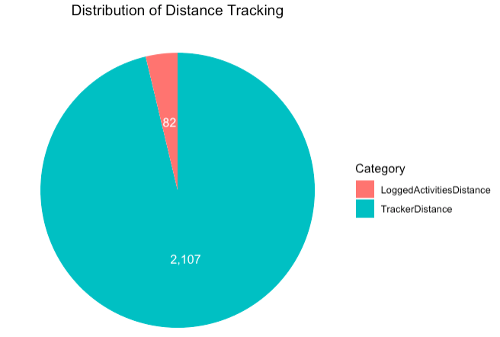
Descriptive Statistics
Metric | Value
Start Date | March 12, 2016
End Date | April 12, 2016
Casual Rides | 1,935,738
Member Rides | 3,517,059
Datapoints | 6,855
• An analysis of wellness user’s activity was conducted over a time period stretching from March 12, 2016, to April 12, 2016. The assessment observed a sample of 6,855 datapoints.
• Majority of user data was passively tracked, the only metrics analyzed in this study where users input data was found in distance tracking. There were 82 logged instances for distance while 2,107 instances of passive tracking. *All data assessed was downloaded from the following website: https://www.kaggle.com/datasets/arashnic/fitbit. This dataset was collected from participants in a survey conducted via Amazon Mechanical Turk. Thirty qualified Fitbit users agreed to share their personal tracker data, which includes minute-level information on physical activity, heart rate, and sleep monitoring. Differences in the data reflect the use of various Fitbit tracker models and individual tracking habits and preferences.

Slide 4
DOCUMENTATION

Slide 5
Documentation: Cleaning
Loading and Checking Data
Installed and loaded required libraries, e.g., `corrplot`, `readr`, `dplyr`, `ggplot2`.
Loaded data using `read_csv` from the `tidyverse`.
Checked the structure (`str`) and the first few rows (`head`) of the dataset for initial insights.
Summarized data using `summary` to understand basic statistics.
Checked for missing values using `sum(is.na(...))` and `colSums(is.na(...))`.
Date Conversion
Converted `ActivityDate` from character to `Date` class using `as.Date` with a specified format.

Slide 6
Documentation: Manipulation
Data Summarization and Calculations
- Calculated the average number of steps per day using `group_by` and `summarize`.
- Found the earliest and latest dates in the dataset using `min` and `max`.
- Counted the total number of data points using `nrow` and `ncol`.
Data Filtering
Filtered out rows with zero or negative values in `VeryActiveMinutes` and `LightlyActiveMinutes` using `filter`.
Reshaping and Transforming Data
- Melted data frame for `distance_data` using `melt` for creating plots.
- Converted data from wide to long format using `pivot_longer` for activity type comparisons.
Summations and Aggregations
- Calculated total sums for different activity distances and minutes using `sum`.
- Created a data frame with calculated total sums for visualization (pie chart).
Correlation Analysis
Computed the correlation matrix on selected numerical columns using `cor`.
Visualization Enhancements
- Applied transformations such as formatting axis labels, customizing colors, and adding labels to plots.
- Used `geom_smooth` for trend lines in scatter plots, enabling clearer expression of relationships.

Slide 7
CALORIES STEPS DISTANCE TYPES

Slide 8
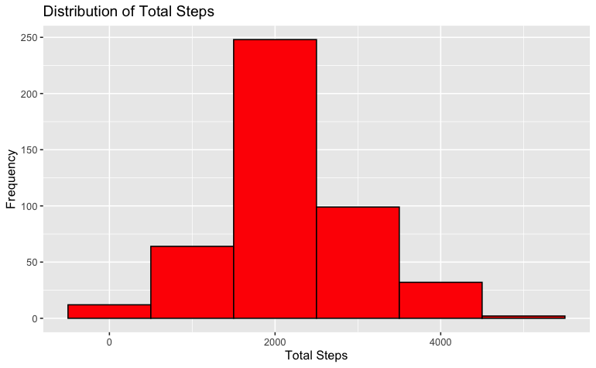
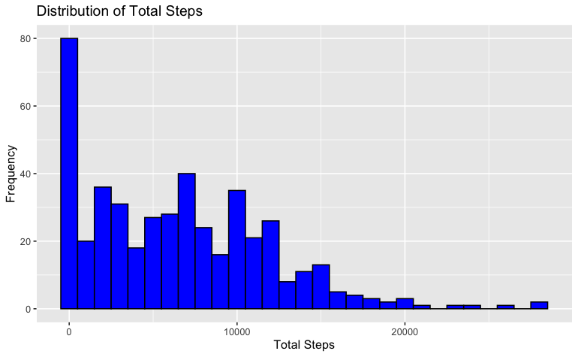
Descriptive Statistics: Calories & Steps
Step Distribution Observation
The histogram shows that most users have a daily step count clustered around 2000 to 2500 steps, indicating a common activity level among the group.
Low Step Frequency at Extremes
There are fewer users with extremely low or high step counts, visible at both ends of the distribution, suggesting that intense activity or inactivity is less common in this dataset.
Bimodal Activity Pattern
The histogram reveals a bimodal distribution with peaks around zero and between 5,000 to 10,000 steps, highlighting varied levels of daily activity among users.
High Inactivity and Moderate Activity
A large number of users recorded step counts near zero, while a moderate proportion of users achieve typical daily step goals, indicating a mix of sedentary and moderately active lifestyles.

Slide 9
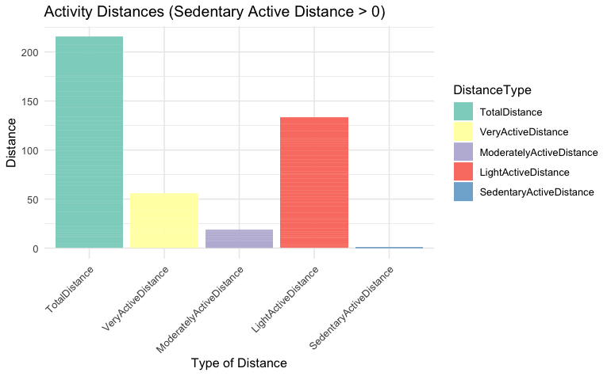
Descriptive Statistics: Distance Types
Variation in Activity Levels: "Very Active Distance" and "Light Active Distance" are leading contributors to the overall distance, suggesting diverse levels of activity intensity among users.

Slide 10
ACTIVE MINUTES

Slide 11
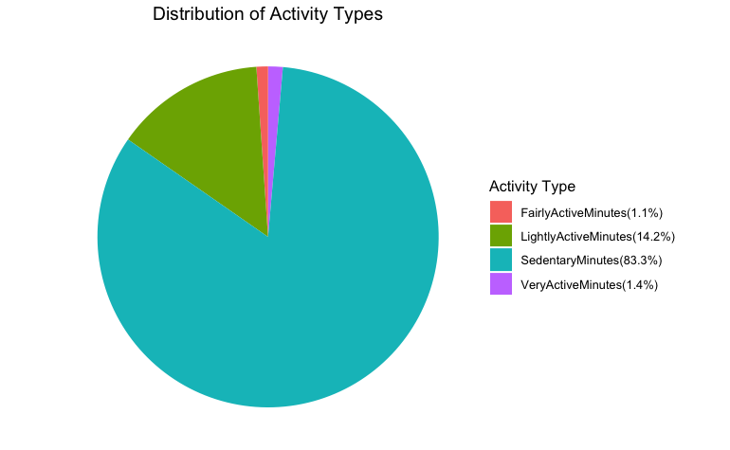
Descriptive Statistics: Active Minutes
Sedentary Dominance
The vast majority of the time (83.3%) is spent in sedentary activities, indicating a significant portion of daily activity is low-intensity or inactive.
Moderate Light Activity
"LightlyActiveMinutes" accounts for 14.2% of the activity, suggesting a moderate level of movement that is not entirely sedentary.
Minimal High-Intensity Activity
Both "FairlyActiveMinutes" (1.1%) and "VeryActiveMinutes" (1.4%) are minimal, highlighting a potential area for encouraging more vigorous or fair activity for balancing lifestyle.

Slide 12
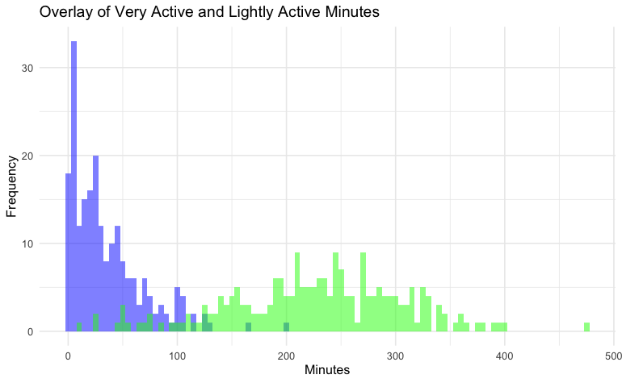
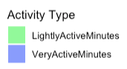
Descriptive Statistics: Active Minutes
Activity Type | Average Activity Length
Very Active | 26min
Lightly Active | 3hr 50min
The average length of lightly active minutes (3 hours and 50 minutes) significantly surpasses very active minutes (26 minutes), suggesting a predominance of lower intensity activities in daily routines.
The overlay histogram reveals that lightly active minutes have a broader distribution, indicating variability across users, while very active minutes are more concentrated at lower durations.
- This disparity in activity levels underscores the opportunity to encourage more vigorous activities for balanced fitness plans and/or to focus marketing efforts towards the much more commonly engage activity time length: Lightly Active.

Slide 13
CORRELATION MATRIX

Slide 14
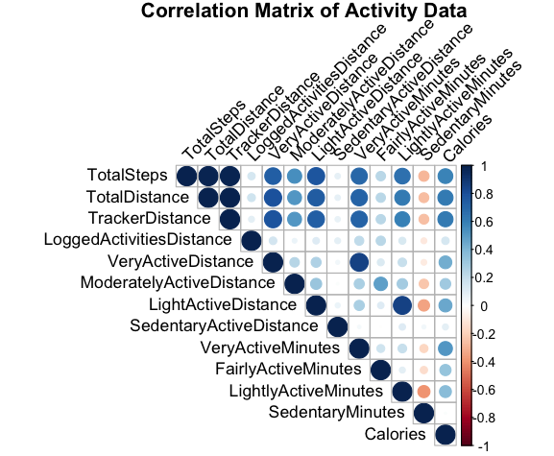
Correlation Matrix
Correlation Coefficient
• The values range from -1 to 1.
• ‘1’ indicates a perfect positive correlation: as one variable increases, the other also increases.
• ‘0’ indicates no correlation: movements in one variable have no predictive relationship with movements in the other.
• ‘-1’ indicates a perfect negative correlation: as one variable increases, the other decreases.
Interpretation: Color and Size
• Darker and larger circles indicate stronger correlations (near 1 or -1), while lighter and smaller circles indicate weaker correlations (near 0).
• Blue circles represent positive correlations, and red circles (not shown here) represent negative correlations.
Observations
High Positive Correlations
• `TotalSteps` and `TotalDistance` show a strong positive correlation, suggesting that as steps increase, the total distance also increases.
• `VeryActiveMinutes` and `VeryActiveDistance` have a strong positive relationship, indicating that more intense activity minutes are associated with greater distances.
Low to Moderate Correlations
• Variables related to different activity intensities, such as `ModeratelyActiveDistance` and `FairlyActiveMinutes`, show moderate correlations.
• `Calories` tends to correlate more with metrics related to intensity and duration of activity.

Slide 15
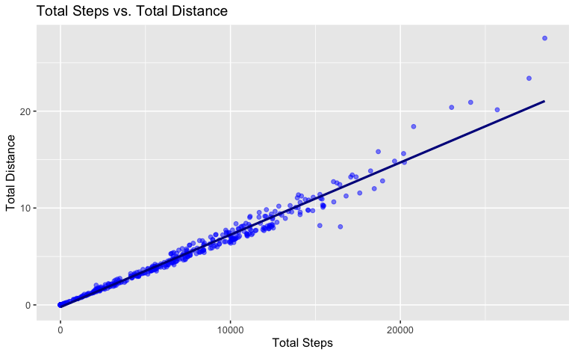
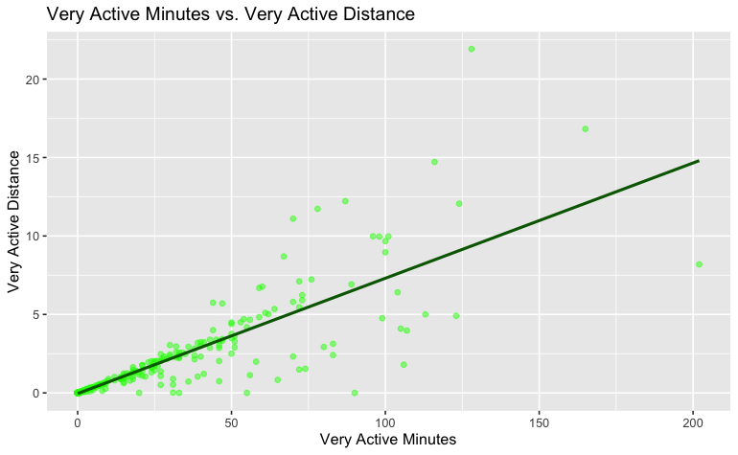
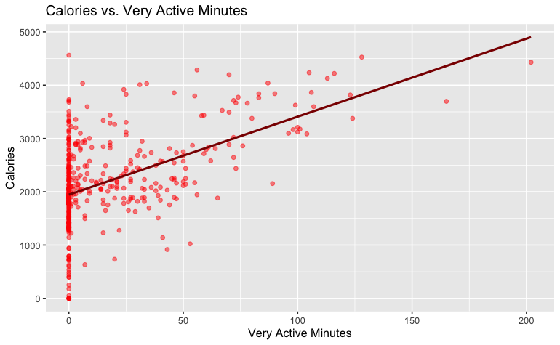
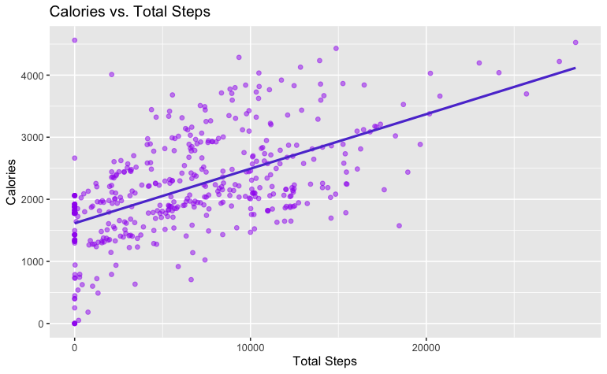
Correlation Matrix
Total Steps vs. Total Distance
- A strong positive linear relationship indicates that as the number of steps increases, the total distance covered also increases.
- This relationship reinforces step count as a valid indicator of overall distance traveled, valuable for tracking physical activity.
Very Active Minutes vs. Very Active Distance
There is a clear positive correlation, as more active minutes correspond to greater distances.
This suggests Very Active Minutes are not done “in-place” and have a movement/distance component to it.
Calories vs. Total Steps
- A positive trend suggests that higher step counts are associated with greater calorie expenditure.
- The linear model indicates that steps can be an effective predictor of calorie burn, useful for users aiming for weight management.
Calories vs. Very Active Minutes
- A positive correlation exists, showing that more very active minutes significantly contribute to higher calorie burn.
- This relationship emphasizes the importance of vigorous activity for effective calorie management in fitness plans.

Slide 16
CONCLUSION

Slide 17
Conclusion
What are some trends in smart device usage?
- Predominantly Sedentary Lifestyle: A significant portion of users (83.3%) spends their time engaged in low-intensity or sedentary activities, such as minimal step counts or prolonged inactivity phases.
- Moderate Activity Levels: The average daily engagement is 3 hours and 50 minutes of lightly active movement, with only 26 minutes of very active pursuits. Light activities thus dominate users' daily routines.
- Bimodal Activity Distribution: Users exhibit a wide range of activity levels, with step counts frequently clustering around two peaks: sedentary phases (close to zero steps) and moderate activity (5,000 to 10,000 steps daily).
- Correlations Between Activity Metrics: Strong positive correlations are observed between `TotalSteps` and `TotalDistance` and between `VeryActiveMinutes` and `VeryActiveDistance`, indicating that more time spent in higher intensity activities correlates with greater distances and increased calorie burning.
How could these trends apply to Bellabeat customers?
- Targeting Predominant Activity Levels: Recognizing that most users engage in moderate or lightly active levels, Bellabeat can develop tailored features or guidance aimed at boosting these existing habits.
- Sedentary Lifestyle Intervention: Since sedentary behavior is dominant, Bellabeat could focus on encouraging more movement throughout the day, perhaps by introducing gentle reminders or tailored micro-exercise prompts.
- Leveraging Light Activity Trends: Since lightly active minutes are more widespread, Bellabeat should consider programs or challenges aimed at enhancing existing light activity moments, fostering better engagement without drastically altering daily routines.
How could these trends help influence Bellabeat's marketing strategy?
- Focus on Incremental Activity Improvements: By highlighting the importance of light and moderate exercises, Bellabeat can position its products as tools for incremental lifestyle adjustments—appealing to those reluctant to adopt high-intensity workouts.
- Promote Calorie Management Features: Given the positive correlation between activity (steps, active minutes) and calorie expenditure, marketing can emphasize how using Bellabeat can support effective weight management through increased daily movement.
- Customized User Experience: Bellabeat can leverage its insights into user activity levels to offer personalized user journeys, making their products feel more attuned to individual lifestyle rhythms and thus more engaging and relevant.
- Educational Campaigns for Increased Activity Intensity: Educating customers on the benefits of increasing their activity intensity could broaden Bellabeat’s reach into the fitness market and encourage users looking to elevate their fitness levels.

